Slide 1
Front End Development
Module2: CSS3 for Front End Development

Slide 2
Understand the fundamentals of CSS
Understand styling by selectors
Use CSS3 New Element styles
Understand positioning, display and float properties
Understand responsive styling using media queries

Slide 3
#No | Module Topics
1 | CSS Fundamentals
2 | Selectors
3 | Pseudo Classes and Elements
4 | CSS3 Text Effects
5 | CSS3 Background Image
6 | CSS3 Border and Box Shadow
7 | CSS3 Color
8 | Media Queries
9 | Working with Display, Float and Position properties

Slide 4

Insights into CSS Fundamentals

Slide 5
CSS Fundamentals
Introduction to CSS
body { background-color:#d0e4fe; } h1 { color:orange; text-align:center; } p { font-family:"Times New Roman"; font-size:20px; }
CSS stands for Cascading Style Sheets
It is a W3(World wide web) standard for describing the presentation semantics of Web pages, including colors, layout, and fonts.
Styles help us in displaying HTML elements.
CSS separates design elements from structural logic.
CSS can be used to style pages in:
HTML
XHTML
XML

Slide 6
CSS Fundamentals
CSS Rule
CSS rule has two parts:
Selector
It is the HTML element you want to style
CSS also allows you to specify your own selectors called id and class
Declaration : It consists of
Property : it is a style attribute you want to change
Value : Each property has a value
Selector
Declaration
h1
{color: green;}
Property
Value

Slide 7
CSS Fundamentals
CSS Syntax
There are three ways to work with a style sheet:
Type | Description | Example
Inline | Defines the style attribute in the relevant HTMl element | <p style="color:blue;margin-left:28px">This is a paragraph.</p>
Internal | Styles are defined the head section of the HTML page using the <style> tag This can be used in case of a unique style for a particular page | <head> <style type="text/css"> hr {color:cyan;} p {margin-left:28px;} body{backgroundimage:url("images/Lilies.gif");} </style> </head>
External | External Sytle sheet is a separate file with an extension .css The styles defined in the css can be applied to more than one page by linking the css file to the HTML page This is done using the <link> Tag | <head> <link rel="stylesheet" type="text/css" href="mystyle.css" /> </head>

Slide 8
CSS Fundamentals
Demonstration
Embedding Style in a document
Inline
Internal
External

Slide 9
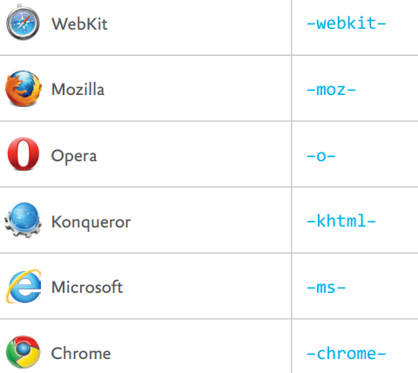
CSS Fundamentals
CSS Vendor Specific Prefixes
CSS3 specification is a series of modules that are being rolled out by browser vendors.
In some cases this rolling out involves experimental support.
This type of experimental support for CSS properties is handled by the use of a vendor prefix.
Ex : -webkit-border-radius

Slide 10
CSS Fundamentals
Units
Units | Description
em | It is a relative measurement. Represents the multiplier of the parent element’s computed font size
px | It is an absolute measurement. Represents pixel unit, 96 pixels per inch
pt | It is an absolute measurement. Represents point unit, 72 points per inch
pc | It is an absolute measurement. Represents pica unit, 12 points per pica
in | It is a absolute measurement (inch)
mm | It is a absolute measurement (millimeter)
cm | It is a absolute measurement (centimeter)

Slide 11
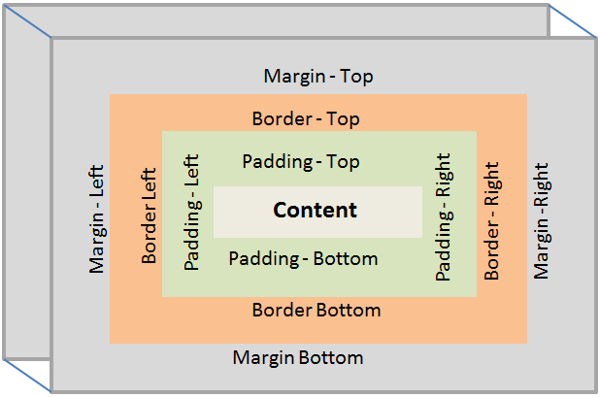
CSS Fundamentals
Box Model
Each element displayed in a document posses one or more rectangular boxes.
These boxes describes how the elements is laid out in a web page.
The diagram describes how an elements margin, padding and border properties determine the layout of element on web page.

Slide 12
CSS Fundamentals
Class Discussion
Choose the components of CSS Style rule:
Property
Selector
Value
All of above

Slide 13
Insights into Selectors

Slide 14
SELECTORS
CSS Selector
Selectors are pattern to match an element of web page and apply respective styling.
There are various ways to define selectors:
Element
Id
Class
Universal
Grouping
Attribute

Slide 15
SELECTORS
CSS Selector
Selector | Description
p { color: blue; } | Element Type Selector: It represents an instance of the element type in the document tree.
#error { color: red; } | Id Selector: It defines style rules based on the id attribute of an element. ‘#’ notation is used to access element id propery.
.container { color: blue; } | Class Selector: It defines style rules based on the class attribute of the elements. ‘.’ notation is used to access the class property

Slide 16
SELECTORS
CSS Selector
Selector | Description
* { margin: 0; padding: 0; } | Universal Selector: It represents any single element in the document tree It is written with an asterisk(*)
h1, h2, h3 { font-weight: normal; } | Grouping Selector: It represents more than one element that share same style.
[href]{ font-style: italic; } | Attribute Selector : It represents elements with the href attribute, whatever the value of the attribute.

Slide 17
SELECTORS
CSS Selector
Selector | Description
h1 article { color: green; } | Descendent Selector:It selects element that is descendent of another element. Its applies style to child , or child of child.
ul > li { list-style: square; } | Child Selector: It selects elements that are direct child of the matching element.
h1 ∼ p { color: blue; font-size: 18px; } | Sibling Selector: It selects elements that is one of the next sibling of the matching element.

Slide 18
SELECTORS
Demonstration
Selectors

Slide 19
SELECTORS
Class Discussion
Choose the selector to give color to elements with class container
input[type=container]
{
color: olive;
}
#container
{
color :olive;
}
.container
{
color :olive;
}
container
{
color:olive;
}

Slide 20
SELECTORS
CSS Specificity
CSS Specificity assist the browser to decide which CSS property values are most relevant to an element to be applied.
Specificity only applies when the same element is targeted by multiple declarations.
When multiple declarations have equal specificity, the last declaration found in the CSS is applied to the element.

Slide 21
SELECTORS
CSS Specificity
div
{
width: 100px;
height : 100px;
}
.bluebox
{
background-color: blue;
}
.olivebox
{
background-color: olive;
}
<div class=“bluebox olivebox”></div>
Last Shall Be First!!

Slide 22
SELECTORS
CSS Specificity
Inline Styles have highest specificity by overriding styles defined in external stylesheet.
Below is priority of style applied (Highest to Lowest) :
Inline
ID(#)
Class, Attribute, Pseudo Classes
HTML Element and Pseudo Elements

Slide 23
SELECTORS
CSS Specificity
h2 {
color: blue;
}
.header {
color: red;
}
<h2 class="header">Heading 2</h2>
Heading 2
Class has higher specificity compare to Element Type!!
23

Slide 24
SELECTORS
Class Discussion
Choose the output for below style:
<style>
#container
{
color: olive;
}
.container
{
color: blue;
}
div
{
color: yellow;
}
</style>
<div id="container" class="container" >Container</div>
Container
Container
Container
Container

Slide 25
SELECTORS
Demonstration
Specificity
Multiple Declaration
Element Style v/s Class Style

Slide 26
Insights into Pseudo Classes and Elements

Slide 27
Pseudo Classes and Elements
Pseudo Classes
The pseudo-class makes selection :
Elements that are part of document tree that cannot be expressed using simple selectors e.g. no ID or class rather be expressed as first child , last child.
Elements dynamic state e.g. hover , focus
A pseudo-class always consists of a "colon" (:) followed by the name of the pseudo-class and optionally by a value between parentheses.
Types of pseudo classes:
Dynamic Pseudo Classes
Structural Pseudo Classes
selector:pseudo-class { property: value; }

Slide 28
Pseudo Classes and Elements
Dynamic Pseudo Classes
Pseudo Classes | Description
a:link { color: blue; } | : link : applies to all unvisited links.
a:visited { text-decoration: none; } | :visited : applies to all visited links.
div:hover { color: red; } | :hover: applies when a user places cursor over the element, but does not select it.
a:active { color: gray; } | :active : applies when the element is activated or clicked.
input[type=“text”]:focus { color: yellow; } | :focus : applies when the element has keyboard focus

Slide 29
Pseudo Classes and Elements
Structural Pseudo Classes
Pseudo class | Description
:root | represents an element that is the root of the document
:nth-child() | The :nth-child(n) pseudo-class notation represents an element that has n-1 siblings before it in the document tree
:nth-last-child() | he :nth-last-child(an+b) pseudo-class notation represents an element that has an+b-1 siblings after it in the document tree, for any positive integer or zero value of n, and has a parent element
:first-child | represents an element that is the first child of some other element
:empty | represents an element that has no children at all

Slide 30
Pseudo Classes and Elements
Demonstration
Pseudo Classes
Dynamic Pseudo Classes
Structural Pseudo Classes

Slide 31
Pseudo Classes and Elements
Class Discussion
Choose the pseudo styling to change font color of second list item of unordered list to green.
ul li:nth-child(second){ color: green;}
ul li:2nd-child{color-green;}
ul li:nth-child(2){color:green;}
ul~li:nth-child(2){color:green;}

Slide 32
Pseudo Classes and Elements
Pseudo Elements
Pseudo-elements create abstractions about the document tree beyond those specified by the document language.
For instance, document languages do not offer mechanisms to access the first letter or first line of an element's content.
A pseudo-element is made of two colons (::) followed by the name of the pseudo-element.
selector::pseudo-element { property: value; }

Slide 33
Pseudo Classes and Elements
Pseudo Elements
Pseudo element | Description
p::first-line { color: #ff0000; font-variant: small-caps; } | ::first-line :describes the contents of the first formatted line of an element
p::first-letter { color: #ff0000; font-size: xx-large; } | ::first-letter : represents the first letter of an element, if it is not preceded by any other content (such as images or inline tables) on its line. The ::first-letter pseudo-element may be used for "initial caps" and "drop caps", which are common typographical effects.
h1::before { content: url("images/marker-left.gif"); } | :before : used to insert some content before the content of an element.
h1::after { content: url("images/marker-right.gif"); } | :after:used to insert some content after the content of an element

Slide 34
Pseudo Classes and Elements
Demonstration
Pseudo Elements

Slide 35
Insights into CSS3 Text Effects

Slide 36
CSS3 Text Effects
CSS3 introduces a range of new and updated text and typographic features.
Provides means for creating decorative headlines and flashy effects

Slide 37
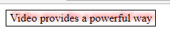
CSS3 Text Effects
Text-shadow: this property applies drop shadows to text
E { text-shadow: x y; }
E { text-shadow: x y color; }
E { text-shadow: x y blur-radius color; }
<p id="para1"> Video provides a powerful way to help you prove your point.</p>
#para1
{
/* offset-x | offset-y | blur-radius | color */
text-shadow: 3px -3px 8px red;
}

Slide 38

CSS3 Text Effects
Text Colors
E {
-webkit-text-fill-color: color;
-webkit-text-stroke-color: color;
-webkit-text-stroke-width: length;
}
#para2
{
font-size: xx-large;
font-weight: bold;
-webkit-text-fill-color: red;
-webkit-text-stroke-color: yellow;
-webkit-text-stroke-width: 3px;
}

Slide 39
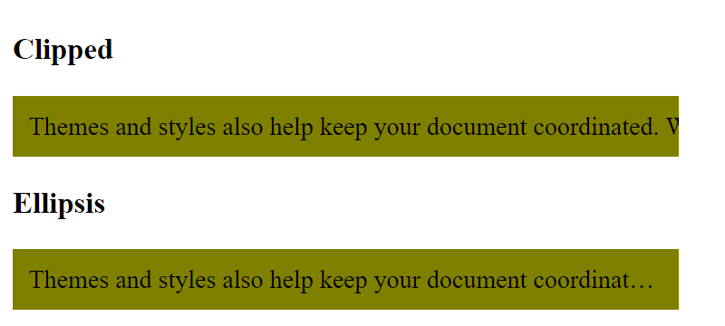
CSS3 Text Effects
Text Overflow: Text can overflow, when it is prevented from wrapping.
E { text-overflow: clip; }
E { text-overflow: ellipsis; }
p {
width: 400px;
padding: 10px;
overflow: hidden;
white-space: nowrap;
background: olive;
}
p.clipped {
text-overflow: clip;
}
p.ellipses {
text-overflow: ellipsis;
}

Slide 40
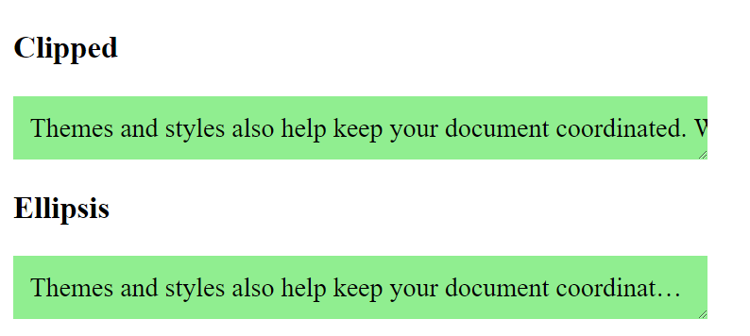
CSS3 Text Effects
resize : For the elements whose contents are wider than their container, The resize property gives users control over an element’s dimensions, providing a handle with which a user can drag the element out to a different size.
E { resize: keyword; }
p {
width: 400px;
padding: 10px;
overflow: hidden;
background: olive;
resize : both;
}
p.clipped {
text-overflow: clip;
}
p.ellipses {
text-overflow: ellipsis;
}

Slide 41
CSS3 Text Effects
Demonstration
CSS3 Text Effects
- Text Shadow
- Text Color
- Text Overflow
- Resize

Slide 42
Insights into CSS3 Background Image

Slide 43
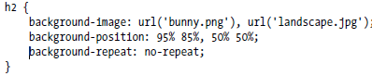

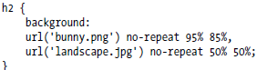
CSS3 Background Image
CSS3 Multiple Background images
Unlike the previous versions, CSS3 allows multiple images to be applied to an elements background.

Slide 44
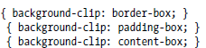

CSS3 Background Image
Background Size and Clip
Background Size :This property allows scaling of background images
E { background-size: width height; }
To resize a background image to be 100px wide and 200px high,
div { background-size: 100px 200px; }
Background Clip : Sets the section of the box model that becomes the limit of where the background (either color or image) is displayed

Slide 45
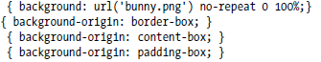
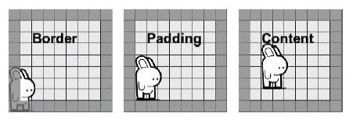
CSS3 Background Image
Background Origin
The background-origin property can be used to specify the positioning area of the background images. It can take the same values as background-clip property: border-box, padding-box, content-box.

Slide 46
CSS3 Background Image
Demonstration
CSS3 Background
- Multiple Background
- Background Clip
- Background Origin

Slide 47
Insights into CSS3 Border and Box Shadow

Slide 48
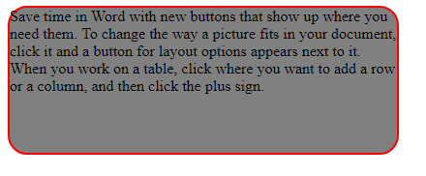
CSS3 Border and Box Shadow
CSS3 Border
border-radius: this property can be used to create rounded corners.
E { border-radius: value;}
.box {
width: 300px;
height: 150px;
background:gray;
border: 2px solid red;
border-radius: 20px;
}

Slide 49
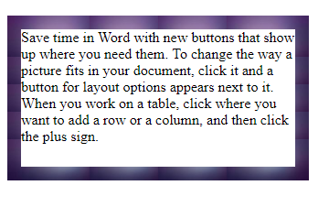
CSS3 Border and Box Shadow
CSS3 Border
border-image: this property allows to specify image as element border.
E { border-image: source width repeat;}
.box2
{
width: 300px;
height: 150px;
border: 15px solid transparent;
border-image: url("solidback.jpg") 30 repeat;
}

Slide 50
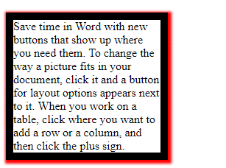
CSS3 Border and Box Shadow
CSS3 Box Shadow
box-shadow: this property can be used to add shadow to the element's boxes.
E{box-shadow :. offset-x | offset-y | blur-radius | spread-radius | color;}
.box1
{
border:10px;
border-style: solid;
box-shadow:2px 2px 4px 3px red;
width:200px;
}

Slide 51
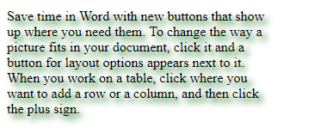
CSS3 Border and Box Shadow
CSS3 Text Shadow
text-shadow: this property can be used to apply the shadow effects on text.
E{text-shadow: hshadow vshadow blurradius color;}
.box2
{
text-shadow: 5px 5px 10px darkgreen;
width : 300px;}

Slide 52
CSS3 Border and Box Shadow
Demonstration
CSS3 Border and Box Shadow
- Border
- Box Shadow

Slide 53
CSS3 Border and Box Shadow
Class Discussion
Choose the property to apply rounded border:
border-rounded
border-roundstyle
border-radius
border-roundradius

Slide 54
Insights into CSS3 Color

Slide 55
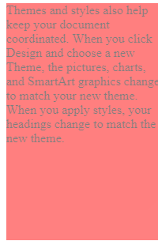
CSS3 ColoR
Opacity is the level of objects resistance to light.
The number value is a decimal fraction—i.e., a number between 0.0 and 1.0, where 0.0 is fully transparent, 1.0 is fully opaque, and any value between those two is a blend of opacity and transparency.
E { opacity: number; }
.container
{
background-color: red;
width: 200px;
height: 300px;
margin-bottom: 10px;
}
.container:hover
{
opacity: 0.5;
}s

Slide 56
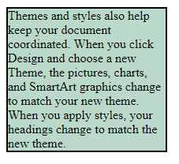
CSS3 ColoR
Colors can be defined in the RGBA model (red-green-blue-alpha) using the rgba().
alpha parameter accepts a value from 0.0 (fully transparent) to 1.0 (fully opaque).
.alpha
{
border: 2px;
border-style: solid;
background-color:rgba(120,180,150,0.5);
width: 200px;
}

Slide 57
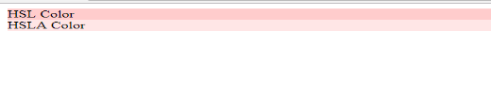
CSS3 ColoR
Colors also can be defined the HSL model (hue-saturation-lightness) using the hsl().
Hue is represented as an angle (from 0 to 360) of the color wheel or circle
Saturation and lightness are represented as percentages.(100% saturation means full color,
and 0% is a shade of gray.)
100% lightness is white, 0% lightness is black, and 50%lightness is normal.
Colors can be defined in the HSLA model (hue-saturation-lightness-alpha) using the hsla().
.container1
{
background-color: hsl(0, 100%, 90%);
}
.container2
{
background-color: hsla(0, 100%, 90%,0.5);
}

Slide 58
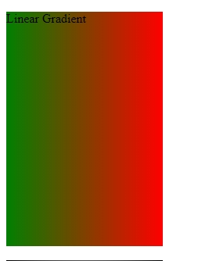
CSS3 Color
Gradient
gradient is a gradual transition between a range of (at least two) colors.
Linear Gradient :
A linear gradient is one that gradually transitions between colors along the full length of the line.
E { background-image:startpoint or angle , from-color, to-color}
.container1
{
background-image: linear-gradient(-90deg,red,green);
OR
background-image: linear-gradient(to left,red,green);
}

Slide 59
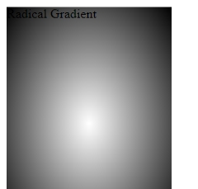
CSS3 Color
Radical Gradient
A radial gradient is the gradual transition between colors, radiating from a central point in all directions.
E { background-image: radial-gradient(from-stop,to-stop); }
background-image:radial-gradient(white, black);

Slide 60
CSS3 Color
Demonstration
CSS3 Color
- Opacity
- HSL and HSLA
- Linear and Radical Gradient

Slide 61
Insights into Media Queries

Slide 62
Media Queries
Provides the ability to apply different styles based on the output device types
A media query consists of a media type and at least one expression that limits the style sheets' scope by using media features, such as width, height, and color.
Media queries, added in CSS3, lets the presentation of content be tailored to a specific range of output devices without having to change the content itself.

Slide 63
Media Queries
Media Queries extend the media types by providing a query syntax that allows serving styles far more specifically to user’s device.
Using media rule
Width and height : width indicates the current width of the browser
@media media and (feature:value) { rules }
@media media and (max-width:480px) { rules }
@media media and (min-width:640px) { rules }

Slide 64
Media Queries
Device width and height:
describes the width of the device that is rendering the page.
Orientation:
optimize your pages for either horizontal or vertical viewing.
media media and (orientation:value) { rules }
/* Mobile phones (portrait and landscape) ---------- */
@media screen and (max-width: 767px){
.container {
width: 100%;
padding: 0 10px;
}
}

Slide 65
Media Queries
Media Types
Media Type | Description
all | Used for all media type devices
aural | Used for speech and sound synthesizers
braille | Used for braille tactile feedback devices
embossed | Used for paged braille printers
handheld | Used for small or handheld devices
print | Used for printers
projection | Used for projected presentations, like slides
screen | Used for computer screens
tty | Used for media using a fixed-pitch character grid, like teletypes and terminals
tv | Used for television-type devices

Slide 66
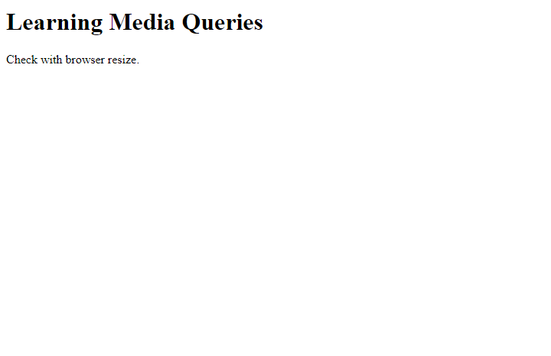
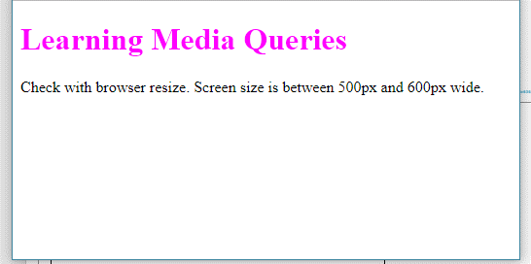
Media Queries
Demonstration

Slide 67
Insights into Working with Display, Float and Position properties

Slide 68
Working with Display, Float and Position properties
Display Property
Display property of an element overrides the box’s types generated by an element.
Value | Description
block | It forces an element to behave as a block level element.
inline | It forces an element to behave as an inline element.
inline-block | It forces an element to generate block box followed by surrounding content.

Slide 69
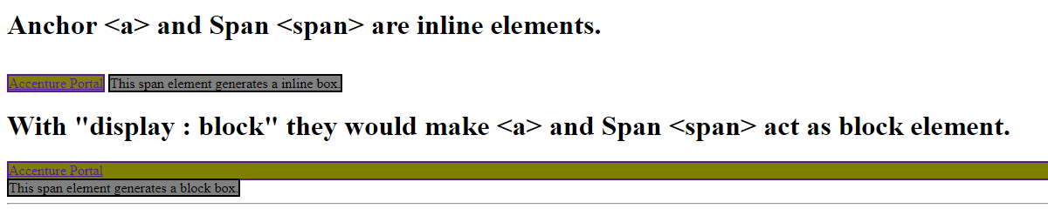
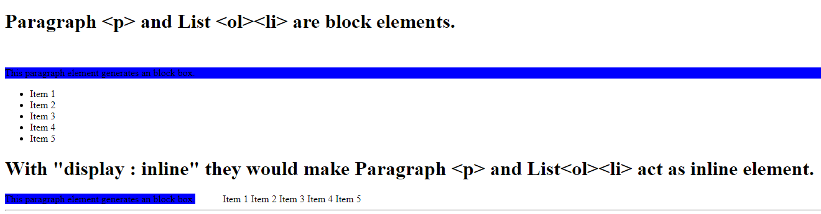
Working with Display, Float and Position properties
Demonstration
Display property.
Inline to Block
Block to Inline

Slide 70
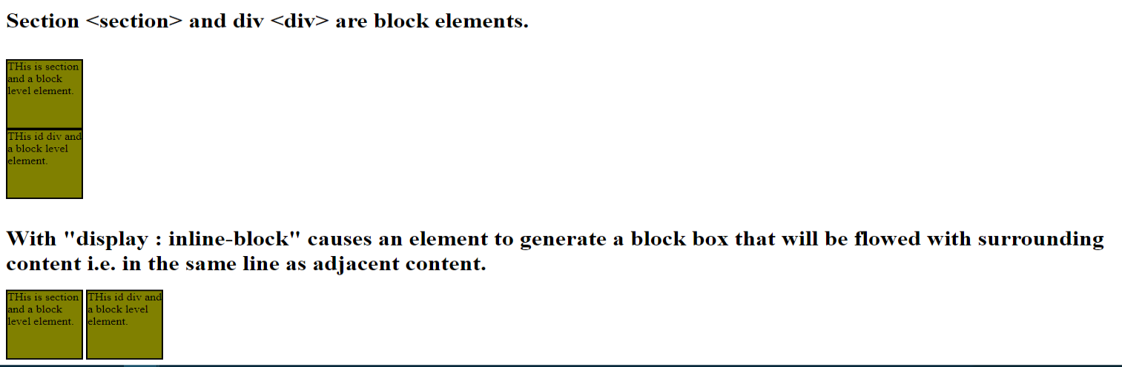
Working with Display, Float and Position properties
Demonstration
Inline-block

Slide 71
Working with Display, Float and Position properties
Float Property
Float property of an element specifies if the box of an element should float or not.
Value | Description
left | The element floats on the left side of its containing block.
right | The element floats on the right side of its containing block.
none | Removes the float property from an element.

Slide 72
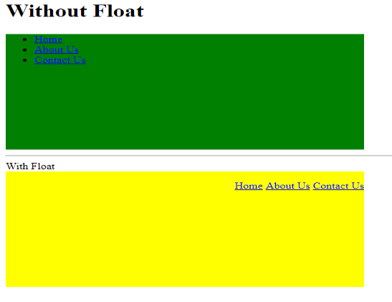
Working with Display, Float and Position properties
Demonstration
Float property

Slide 73
Working with Display, Float and Position properties
Position Property
Position property defines how the element has to be position in a document.
Value | Description
static | The element is positioned according to document flow. By default all html elements are static positioned.
relative | The element positioned relatively according to top or bottom or left or right property values specified.
absolute | It is positioned relatively with offset values specified for top, right, bottom and left.

Slide 74
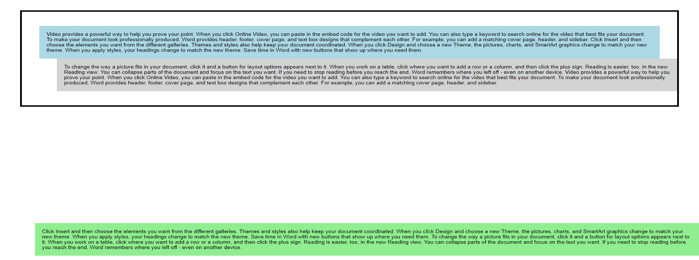
Working with Display, Float and Position properties
Demonstration
Position property

Slide 75
Upon completing this module, you should now be able to:
Embed CSS Styles in a document
Work with selectors
Work with Pseudo Classes and Elements
Write CSS3 Styles
Text
Background Image
Border and Shadow
Colors
Make responsive content using Media Queries.
Work with display , float and position property.

Slide 76
Thank You

